Slide 1
peer2peer lending
COMP 488-003 Team 2
Bernie Chen, Kai Snyder, Nahum Yared, Shreya Gundam, Skye Southall, Sunny Xiaohan Wang

Slide 2
Business Question
How do we identify profitable and low(er)-risk loans?
Criteria for Evaluation —> risk-adjusted returns, taking into account the loan’s
purpose, its term, and applicant FICO score
Risk Assessment —> factors linked to high probability of default and
variance of returns
Our Primary Stakeholder
Dr. D.

Slide 3
Overview of Approach
Consolidate and Combine
Analysis
Data Used:
Accepted loans
Consolidation:
Loan applicants categorized based on FICO credit score
Separate grouping from existing loan grade classification
Key Attributes:
Loan Purpose (e.g. House, Wedding, Education)
Loan Term (length of loan - years)
FICO score classification
Analyze relationship of key attributes and the loan profitability and riskiness
Analyze relationship between loan defaulting and other variables

Slide 4
Key Assumptions
FICO Score
Risk of Loan
Loan Grade
Accurate reflection of applicant’s financial health
Standard deviation (SD) of return is reasonable indicator of risk
Reasonable to use lower range of FICO score to calculate loan grade from Experian
Relevant Loans
Risk-free Rate
Only examined fully paid, charged off, and defaulted loans
Reasonable to use the Treasury Rate as the risk- free rate
Notes:
Fico score takes into account a lot of applicant information already -> no need to do extra analysis on that
Only looked at fully paid, charged off, and defaulted loans
used experian for loan grade bins, took lower range
Assumed SD of loans = riskiness of loan
Relevant Loans -> Grouped together Charged Off and Defaulted loans as unsuccessful
Risk-Free Rate -> Used as the risk-free rate for computing Sharpe Ratio, which is our metric of choice for risk-adjusted returns

Slide 5
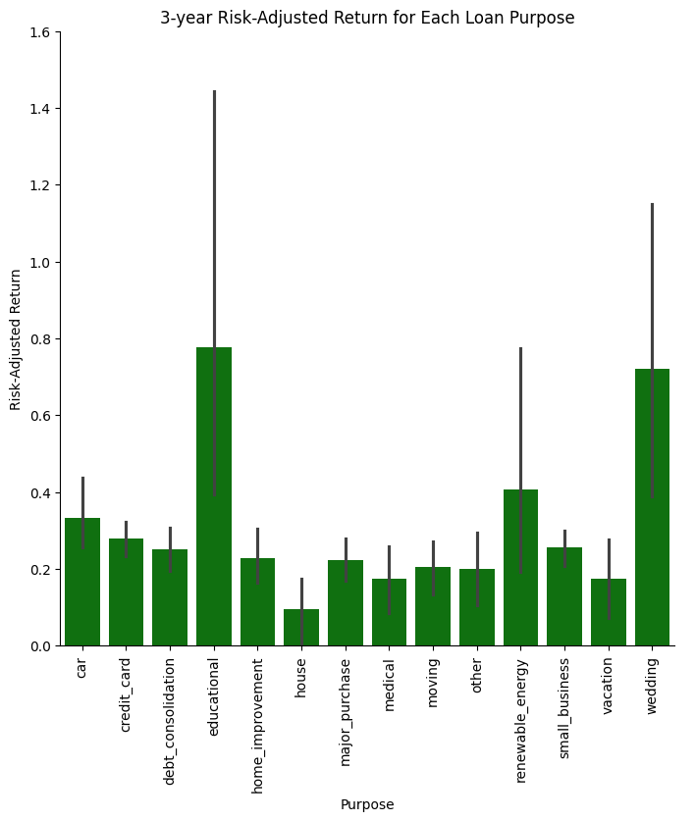
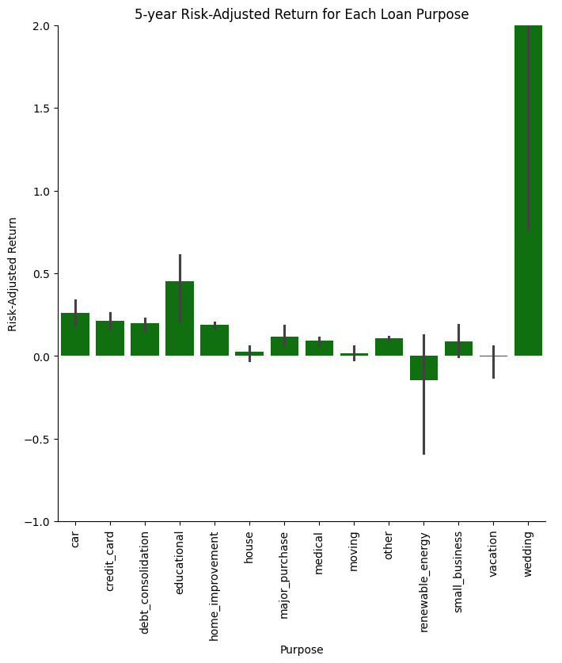
Risk-adjusted Returns
(Expected Return of Loan) - (Risk-Free Rate)
SD of Loan Return for Each Loan Purpose
3 Year
5 Year

Slide 6
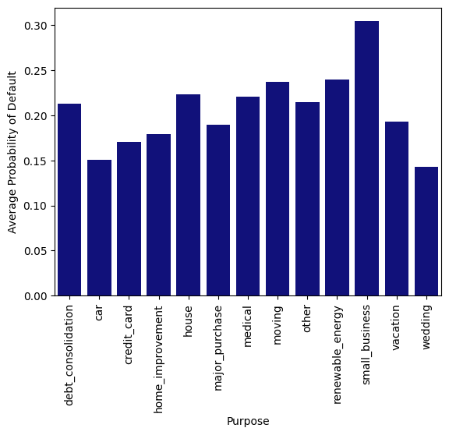
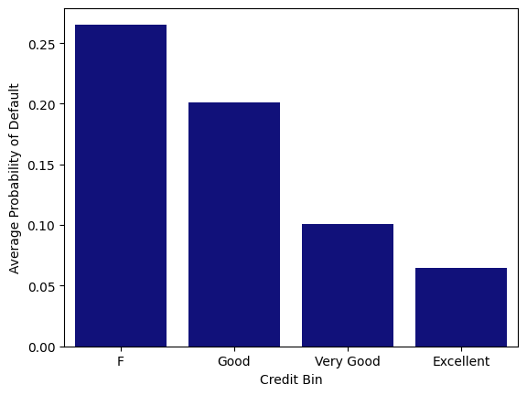
Likelihood of Default
small business loans had the highest avg. probability of default, wedding and car loans had the lowest
as credit score improved, avg. probability of default decreased
Overall, this supports our previous findings that wedding loans by applicants with high credit scores are less risky.
Notes:
Probabilities estimated via logistic regression, where defaulted and charged off loans were marked “unsuccessful” and fully paid off loans were marked “succesfull”
Purposes:
Wedding and Car loans both had the lowest probability of default compared to other types of loans
Additionally, small business, renewable energy, moving, and housing loans all experienced higher rates of default, which coincides with our findings with risk-adjusted returns
Credit Bins:
Intuitively, there is a correlation between having better credit and being less likely to default
Overall, this supports our previous findings
There are also some additional considerations:
36-month term loans have nearly ½ the default rate of 60-month term loans
Individuals who have worked for longer periods of time tend to default less often
People who pay neither a mortgage or pay for rent have a lower probability of default
Joint status loans tend to be paid back more often

Slide 7
Implications and Recommendations
Invest in loans with higher risk-adjusted returns
Wedding and Education loans yielded highest risk-adjusted returns. Housing loans had overall lowest performance.
Loan purpose
3-year loans showed more consistency in returns and lower probability of default than 5-year loans.
Loan term
Small Business loans had highest default probability. Car and Wedding had lowest likelihood of defaulting.
Default rate
Notes:
Identify and invest in loans with higher risk-adjusted returns

Slide 8
References
Team 2
https://www.experian.com/blogs/ask-experian/infographic-what-are-the-different-scoring-ranges/
https://ycharts.com/indicators/3_year_treasury_rate
https://ycharts.com/indicators/5_year_treasury_rate
https://www.forbes.com/advisor/investing/sharpe-ratio/

Slide 9
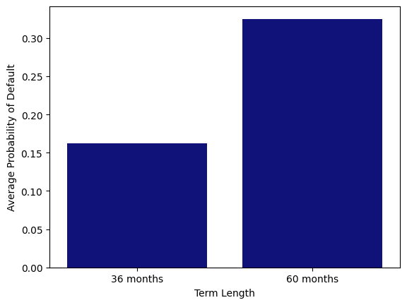
Appendix

Slide 10
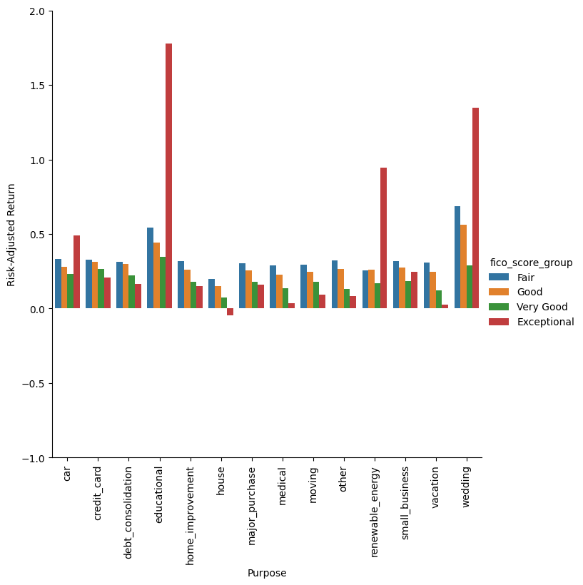
Appendix

Slide 11
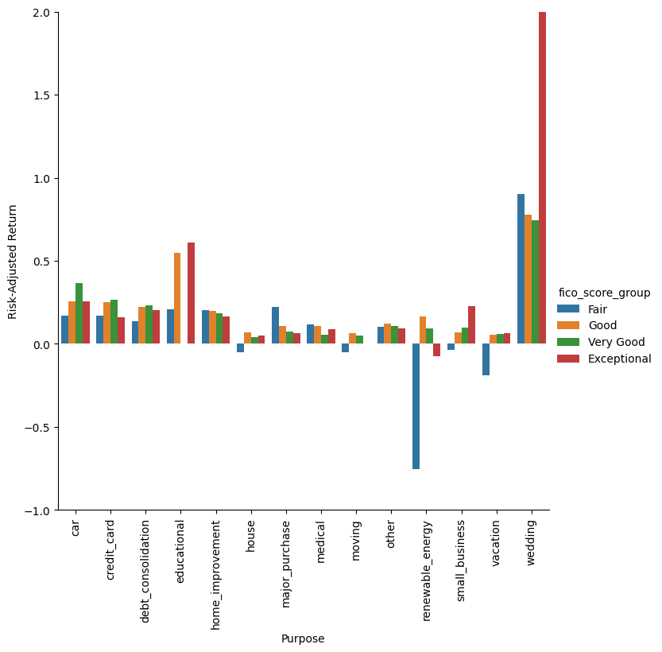
Appendix

